Slide 1

Machine Failure Prediction
Data Analysis and Model Building

Slide 2
Introduction
Objective :-
Predict machine failure using various machine learning models.
Compare model performance to select the best one.
Dataset : -
Industrial equipment maintenance dataset with features like temperature, rotational speed, torque, and tool wear.
Maintenance_new.xlsx

Slide 3
Data Overview
Dataset Description:
Number of samples: 10,000
Number of features: 10
Target variable: Machine failure
Features:
Air temperature [K]
Process temperature [K]
Rotational speed [rpm]
Torque [Nm]
Tool wear [min]
Type (categorical)

Slide 4
Data Preprocessing
Steps Taken:
Dropped unnecessary columns (UDI, Product ID).
Checked for and handled duplicate values.
Managed missing values (if any).
Identified and managed outliers.

Slide 5
Data Distribution
Imbalanced Data:
Machine failure: Imbalanced (more non-failure cases)
Count Plots:
Machine failure distribution
Type distribution

Slide 6
Exploratory Data Analysis (EDA)
Class Imbalance:
Machine failure: Imbalanced dataset.
Visualization: Count plots for machine failure and types.
Distribution Analysis:
Histograms of key features.
Boxplots to detect outliers.

Slide 7
Outlier Treatment
Columns with Outliers:
Rotational speed [rpm]
Torque [Nm]
Method:
Cap and floor using IQR method

Slide 8
Correlation Analysis
Correlation Matrix:
Visualize relationships between features
Heatmap:
Identify highly correlated features

Slide 9
Feature Engineering
One-Hot Encoding:
Categorical variable 'Type' encoded.
Resulting Dataset:
Data shape and new feature columns.

Slide 10
Train-Test Split
Data Split:
Train: 80%
Test: 20%
Random state: 42

Slide 11
Handling Imbalanced Data
SMOTE:
Synthetic Minority Over-sampling Technique
Applied to balance the training dataset

Slide 12
Model Building
Models Evaluated:
Logistic Regression
Random Forest Classifier
XGBoost Classifier
Support Vector Classifier (SVC)
Decision Tree Classifier

Slide 13
Logistic Regression Results
Metrics:
Accuracy: [ 0.97 ]
Precision: [ 0.50 ]
Recall: [ 0.96 ]
F1-score: [ 0.66 ]
ROC-AUC score: [ 0.98 ]

Slide 14
Random Forest Results
Metrics:
Accuracy: [ 0.88 ]
Precision: [ 0.18 ]
Recall: [ 0.81 ]
F1-score: [ 0.30 ]
ROC-AUC score: [ 0.94 ]

Slide 15
XGBoost Results
Metrics:
Accuracy: [ 0.99 ]
Precision: [ 1.0 ]
Recall: [ 0.96 ]
F1-score: [ 0.98 ]
ROC-AUC score: [ 0.98 ]

Slide 16
Support Vector Classifier Results
Metrics:
Accuracy: [ 0.78 ]
Precision: [ 0.10 ]
Recall: [ 0.80 ]
F1-score: [ 0.18 ]
ROC-AUC score: [ 0.86 ]

Slide 17
Decision Tree Results
Metrics:
Accuracy: [ 0.94 ]
Precision: [ 0.37 ]
Recall: [ 0.93 ]
F1-score: [ 0.53 ]
ROC-AUC score: [ 0.97 ]

Slide 18
Model Comparison
Metrics:
Logistic Regression: [ 0.97 ]
Random Forest: [ 0.88 ]
XGBoost: [ 0.99 ]
SVC: [ 0.78 ]
Decision Tree: [ 0.94 ]

Slide 19
Conclusion
Summary:
Logistic Regression performed best overall
Effective handling of imbalanced data using SMOTE
Important features influencing machine failure prediction
Future Work:
Explore additional feature engineering techniques
Evaluate more advanced models

Slide 20
Model Deployment with Streamlit
Introduction:
Deploying the Logistic Regression model using Streamlit.
Allows users to input parameters and get real-time predictions.

Slide 21
Streamlit App Overview
Title:
Model Deployment: Logistic Regression
Sidebar Header:
User Input Parameters
Main Page:
Display the title of the app
Display the user input parameters
Show data summary
Display predicted results and prediction probabilities

Slide 22
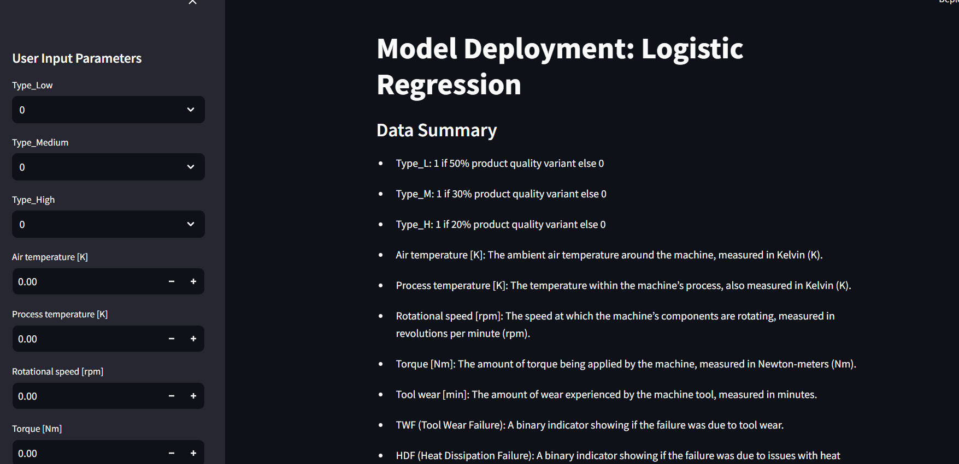

Slide 23
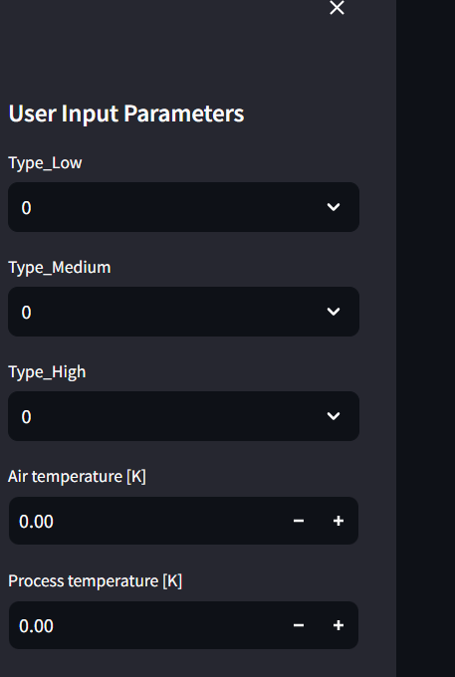
User Input Parameters
Parameters:
Type (Low, Medium, High)
Air temperature [K]
Process temperature [K]
Rotational speed [rpm]
Torque [Nm]
Tool wear [min]
TWF, HDF, PWF, OSF, RNF (binary indicators)

Slide 24
Data Summary
Data Description:
Type_L: 1 if 50% product quality variant else 0
Type_M: 1 if 30% product quality variant else 0
Type_H: 1 if 20% product quality variant else 0
Air temperature [K]
Process temperature [K]
Rotational speed [rpm]
Torque [Nm]
Tool wear [min]
TWF, HDF, PWF, OSF, RNF (binary indicators)

Slide 25
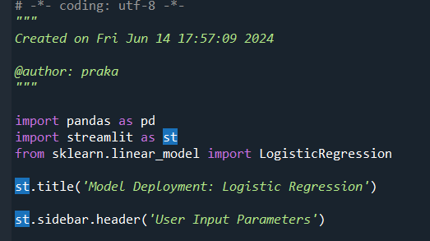
Streamlit App Code - Part 1
Import necessary libraries
Set up Streamlit title and sidebar header

Slide 26
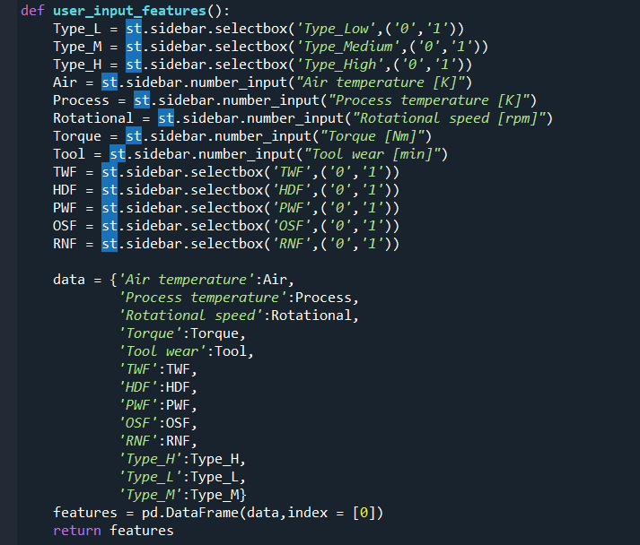
Streamlit App Code - Part 2
Function to capture user input parameters

Slide 27
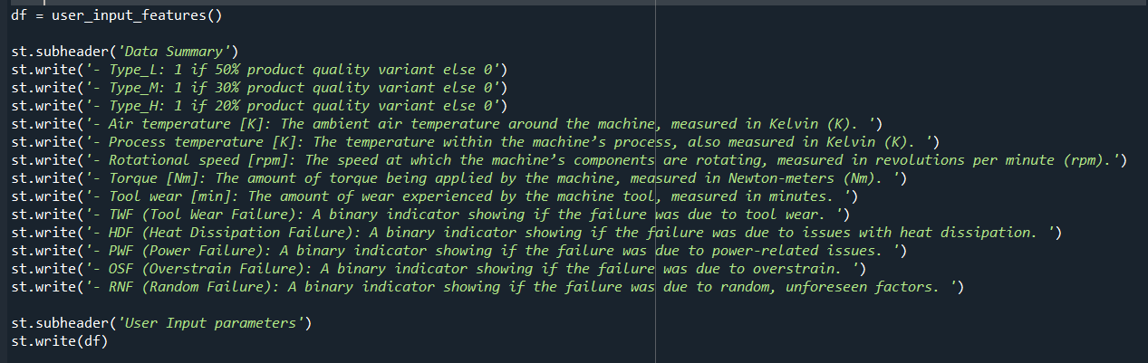
Streamlit App Code - Part 3
Display user input parameters and data summary

Slide 28
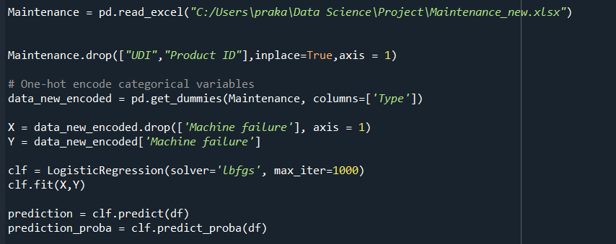
Streamlit App Code - Part 4
Load and preprocess dataset
Train Logistic Regression model
Make predictions

Slide 29
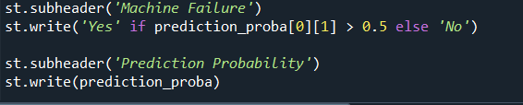
Streamlit App Code - Part 5
Display predicted results and prediction probabilities

Slide 30
CONCLUSION
Summary:
Successfully deployed Logistic Regression model using Streamlit.
Real-time predictions based on user input parameters.
Future Improvements:
Enhance the app with more models.
Improve user interface and experience.

Slide 31

Thank You!
Any question?

